Slide 1
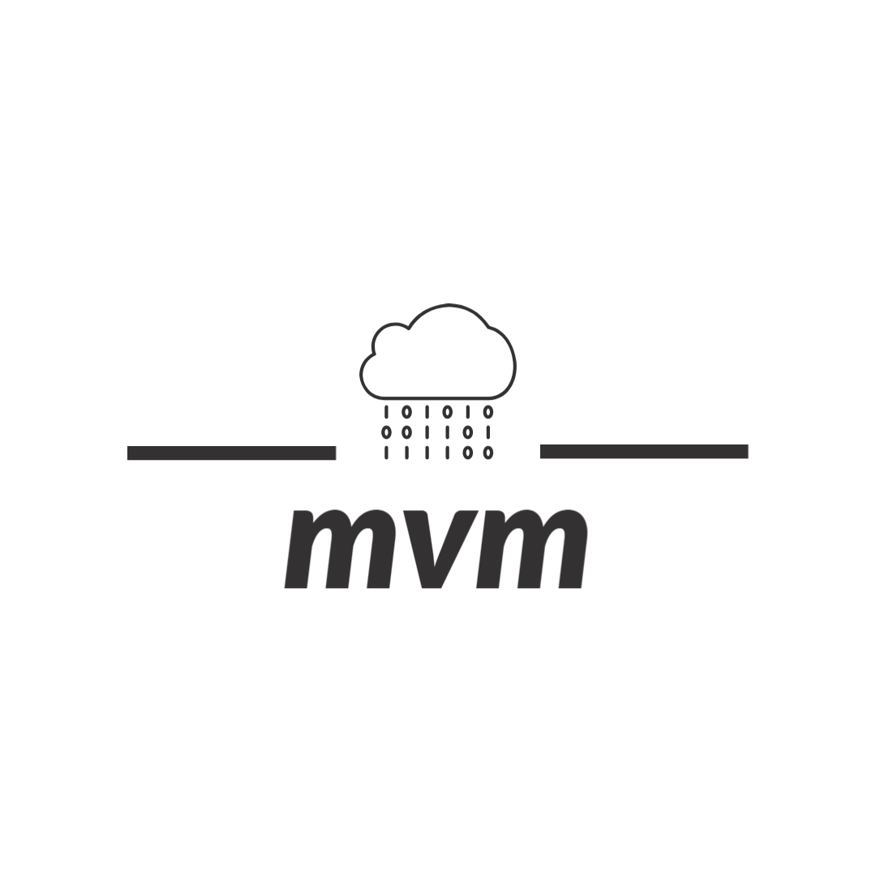

IT USER GUIDE
Mualla Argin
virtual machine - a computer system created using software on one physical computer in order to emulate the functionality of another separate physical computer.
CSCE 412 - Cloud Computing Project 1
Mualla Argin

Slide 2

INTRODUCTION
This how to guide will give you hands-on experience on building a platform suitable for a development environment of software and documentation design. By the end of this guide you will be able to create as many identical virtual machines as you need. In order to create these virtual machines you will need to clone a virtual machine that contains the programs you will utilize. You will do this by downloading all programs you need on a Amazon lightsail instance and then converting that instance to an EC2 instance that you will import into VMware Vsphere for cloning.
Tools Available on Windows OS Virtual Machine:
VSCode (code editor)
MinGW (compiler for C++)
Visual Studio (IDE)
Evernote (document editor)
Adobe Acrobat (PDF viewer)
Why these tools specifically?
These tools come to you and your institution @ NO COST!
they are top tier product in software development and document editing that will aid in organization and time optimization.

Slide 3
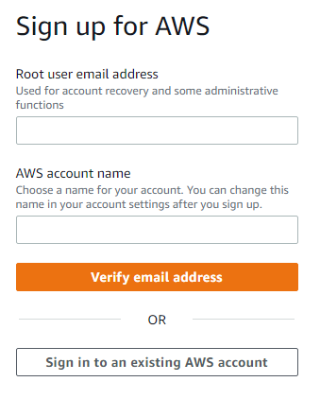
GETTING STARTED
Create an AWS account on https://portal.aws.amazon.com/billing/signup?refid=78b916d7-7c94-4cab-98d9-0ce5e648dd5f&redirect_url=https%3A%2F%2Faws.amazon.com%2Fregistration-confirmation#/start/email

Slide 4
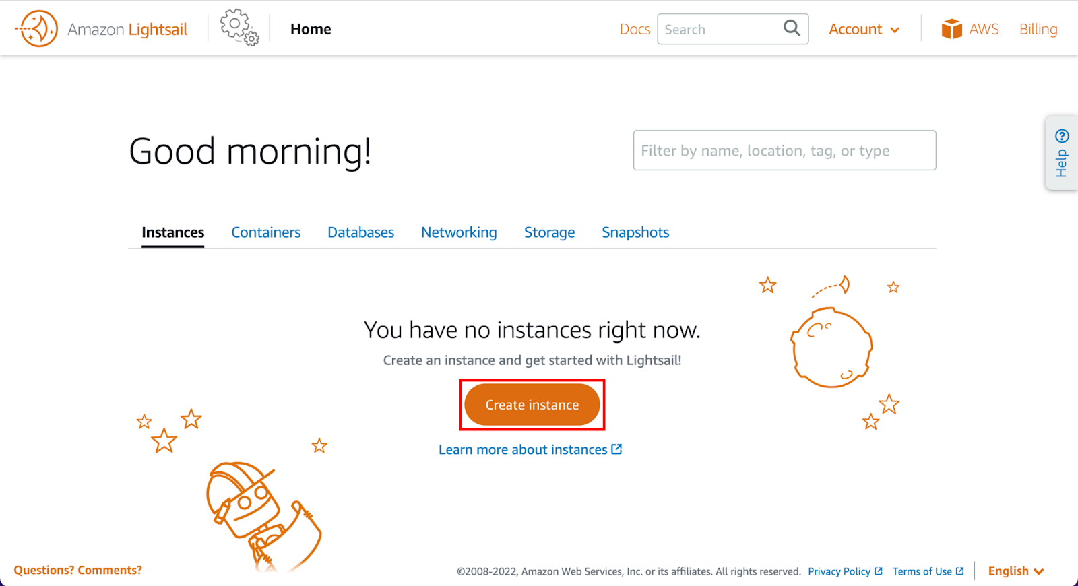
GETTING STARTED
Create a Windows Server 2019 instance in Amazon Lightsail
Choose the create instance button on the instances tab of the Lightsail home page.

Slide 5
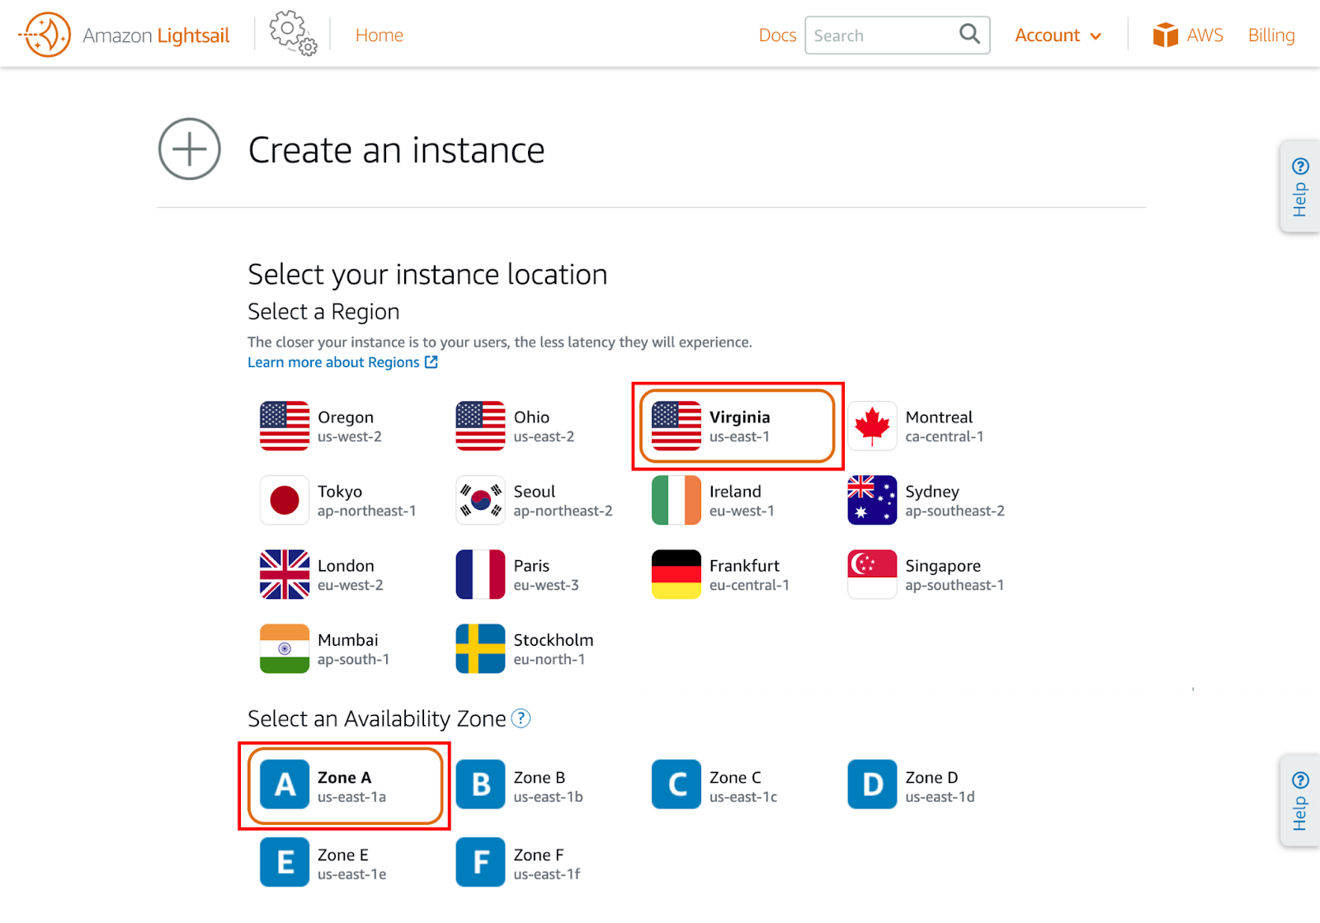
GETTING STARTED
Configure the instance
An AWS region and availability zone is selected for you. Choose change region and availability zone to create an instance in another location. Pick a location and zone that is closest to you.

Slide 6
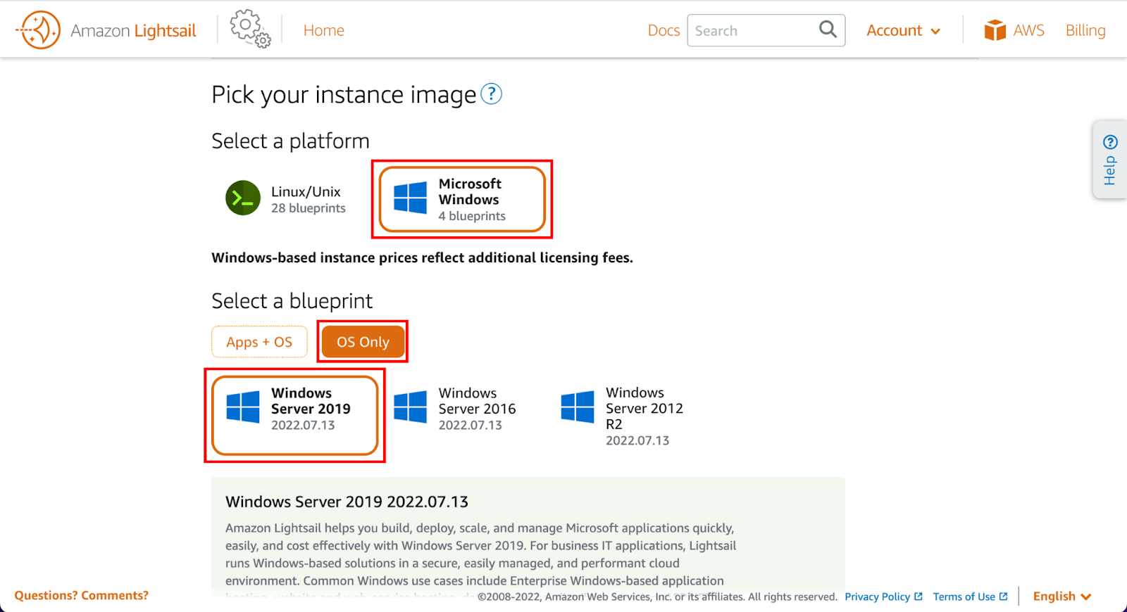
GETTING STARTED
Choose the Microsoft Windows platform option, and choose OS only to view the operating system-only instance images available in Lightsail, Select the Windows Server 2019 image.

Slide 7
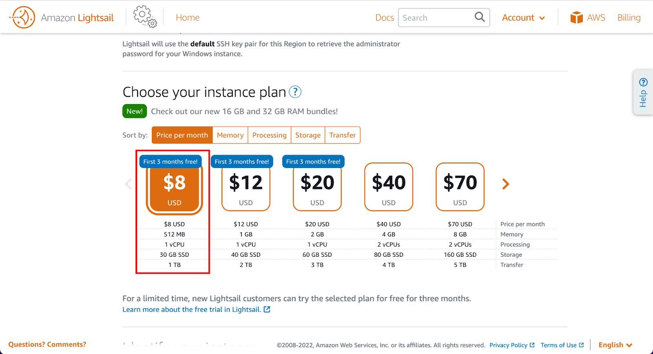
GETTING STARTED
Choose your instance plan : You can try the $8 USD Lightsail plan free for three months. Select the $8 USD Lightsail plan

Slide 8
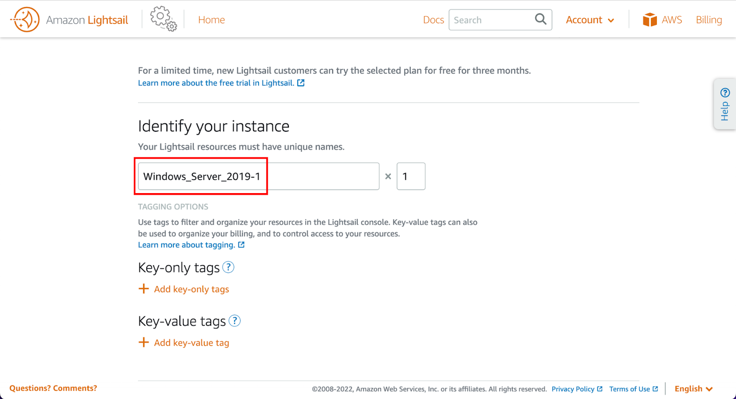
GETTING STARTED
Enter a name for your instance

Slide 9
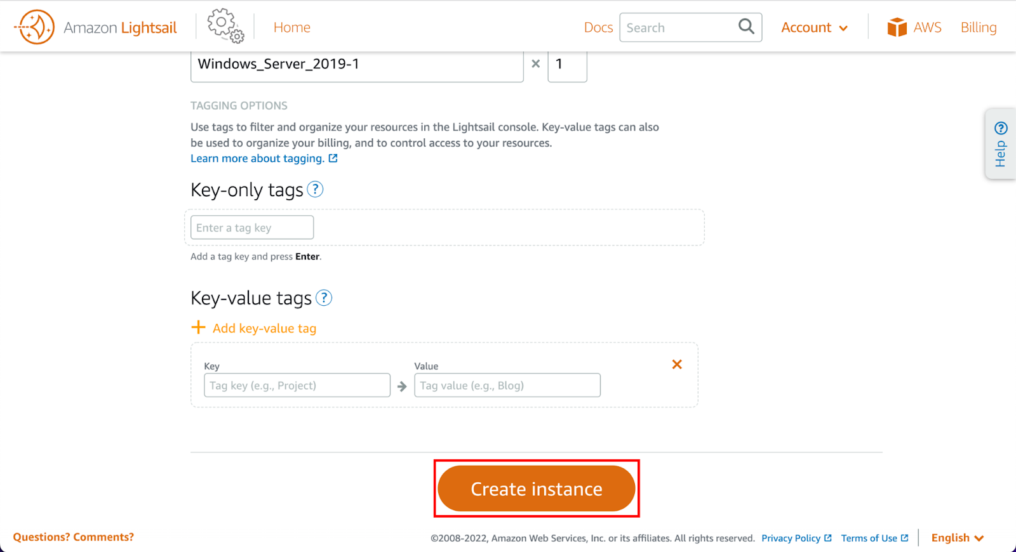
GETTING STARTED
Choose create instance

Slide 10
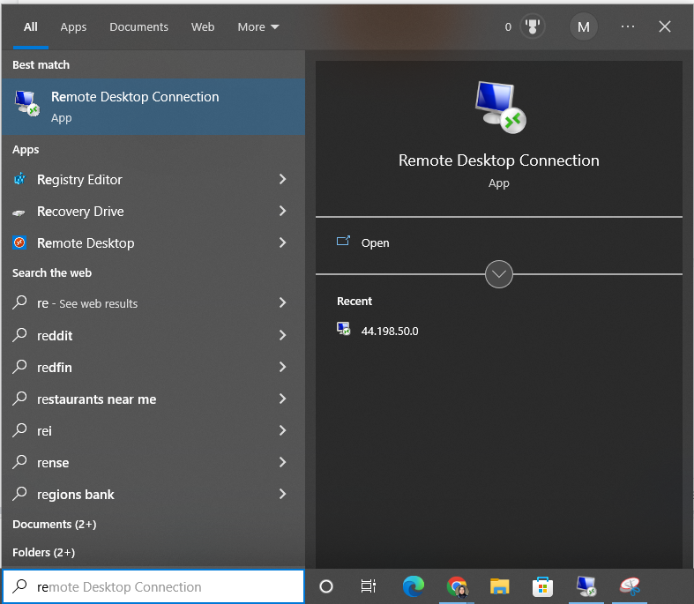
GETTING STARTED
In order to access your virtual environment, you can use remote desktop connection (already installed on Windows Operating System) or download VNC Viewer (https://www.realvnc.com/en/connect/download/viewer/) for other Operating Systems.
For Example:
Open Remote Desktop Connection from START menu

Slide 11
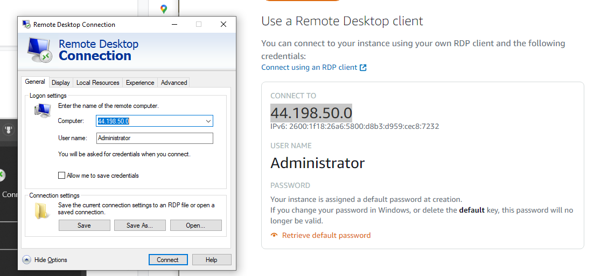
GETTING STARTED
Go to your connect tab on your amazon lightsail dashboard and use the username and connect to details to log in to your remote desktop connection
(in this case computer: 44.198.50.0 username : Administrator) .

Slide 12
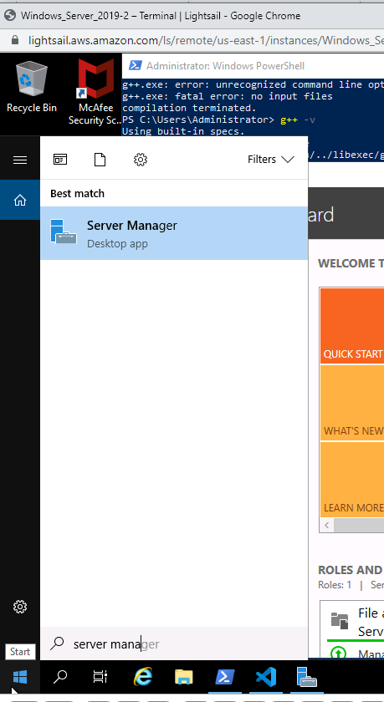
Before downloading anything from internet explorer turn off internet explorer enhanced security configuration. You can do this by going to server manager through the virtual machine windows search box.

Slide 13
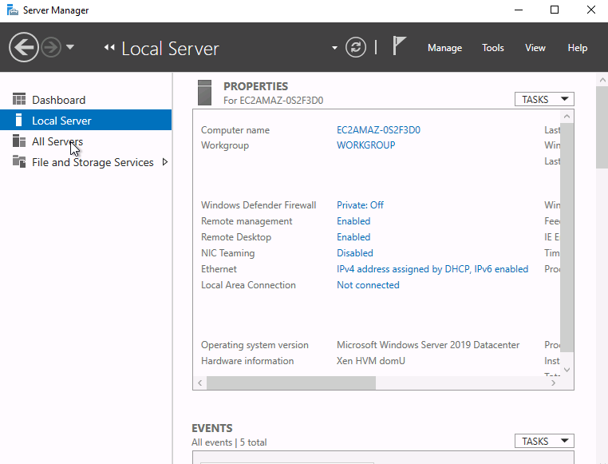
Once you are on server manager redirect to local server

Slide 14
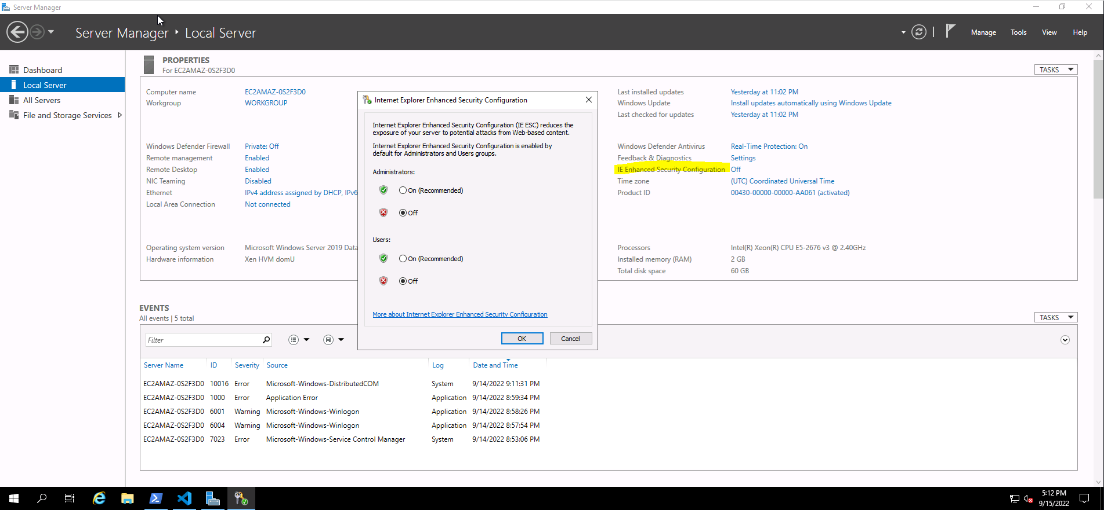
Maximize your screen and click on IE Enhanced Security Configuration. Make sure your internet explorer enhanced security configuration is turned off for both Administrators and Users in the pop up. Save changes.

Slide 15
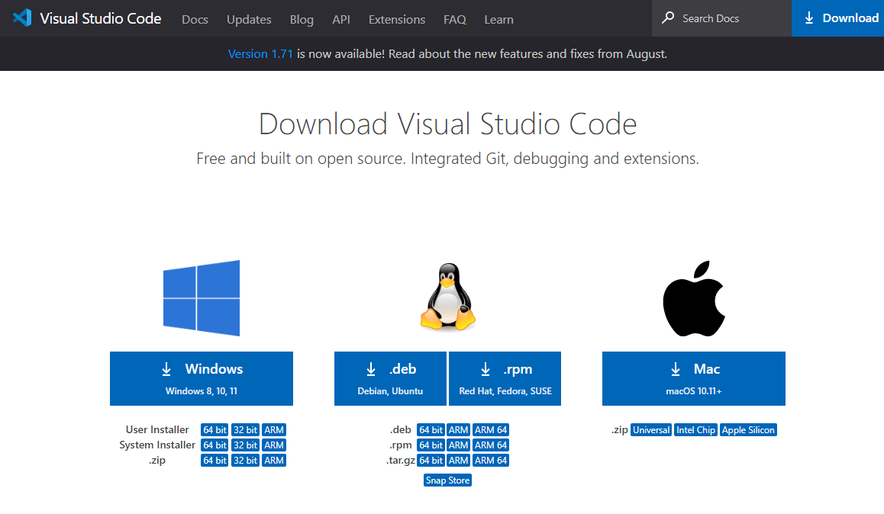
You are now ready to install VSCode (code editor), mingw (compiler), Visual Studio (IDE), Evernote (document editor) and Adobe Acrobat (PDF viewer) to the virtual machine.
You can do this by installing them through their respective sites
VSCode: https://code.visualstudio.com/download
MingW: https://www.mingw-w64.org/
Visual Studio: https://visualstudio.microsoft.com/downloads/
Evernote: https://evernote.com/download
Adobe Acrobat: https://get.adobe.com/reader/

Slide 16
Now that we have all the programs installed we begin cloning!
The cloning procedure requires you to convert your lightsail instance into an ec2 instance and then convert that ec2 instance into a VMware virtual machine. We want to have a VMware virtual machine because VMWare Vsphere Client has a great scheduling tool that we will use to clone our VM as many times as we would like. Don’t forget you need to create an AWS and VMware account for this procedure.
Converting your lightsail instance into an ec2 instance:
Stop Virtual Machine from Connect Tab on Amazon Lightsail Dashboard
Navigate to Snapshots tab & Click Create Snapshot
Give your snapshot a name (Note: It may take > 30 minutes for your snapshot to be ready)
Once your snapshot is ready click the vertical dots next to your snapshot. You should see an option that says export to Amazon EC2. Select this option
Converting ec2 instance into a VMware virtual machine:
Download VMWare Vsphere
You can convert an Amazon EC2 Windows instance to a VMware virtual machine running on an ESXi host that vCenter Server manages by using the Converter Standalone proxy mode feature on Amazon EC2. For more information on this, check out Remote Hot Cloning of Powered Оn Source Machines That Are Running Windows.

Slide 17

Importing VMWare virtual machine into VMWare vsphere:
In the vSphere Client home page, navigate to Home > Hosts and Clusters.
From the inventory tree, right-click the host or cluster to which you want to import virtual machines.
Click Import VMs. ...
Select the source vCenter Server instance from which you want to import virtual machines.
If a Security Alert dialog box appears, click Yes.
Click Next.
Select the virtual machines to import.
Click Next to continue.
On the Ready to complete page, review the details and click Finish.

Slide 18
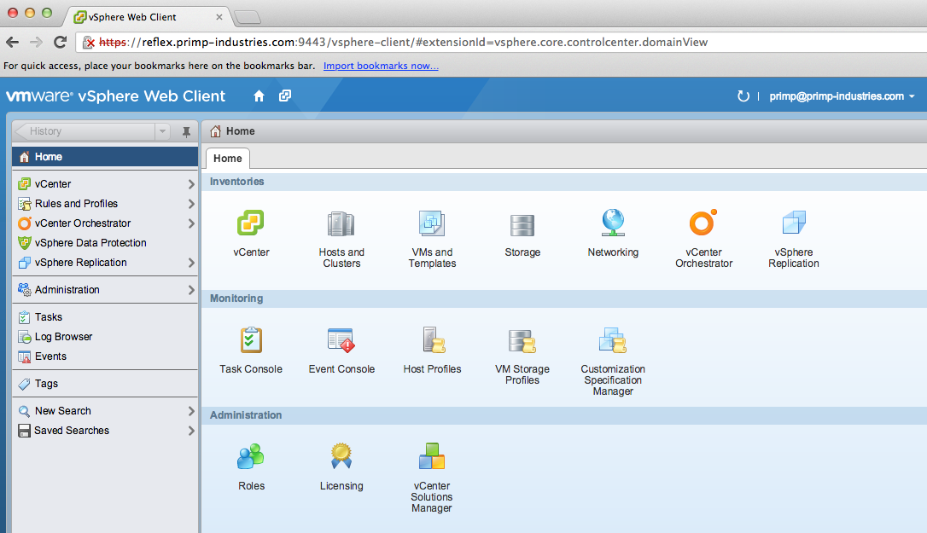
Vsphere cloning (Creating Scheduled Tasks in the Vsphere Web Client):
Open a Web browser and enter the URL for your vCenter Server instance: https://vcenter_server_ip_address_or_fqdn
On the vSphere Welcome page, select Launch vSphere Client (HTML5).
Enter the credentials of a user who has permissions on vCenter Server and click Login.
Navigate to the virtual machine in your inventory
Press Ctrl and right-click your virtual machine
The clock icon indicates the operations you can schedule. Select clone.
Type name and description for clone and then click scheduling options. To set the scheduling options for the task click change. Select set up a recurring schedule for this action. Depending on how many identical virtual machines you would like by X deadline determine a VMware cloning schedule that works best for you (i.e. you want 100 VMs in 20 days schedule 5 virtual machine clonings a day and remove the scheduled task at the end of the 20 days either automatically by setting an end date or manually through web client )

Slide 19

CONTACT US
MVM - Mualla Argin
margin25@tamu.edu
UIN : 728003004

